Slide 1
Subject-oriented programming
Subject means a collection of state and behavior specifications.
It represents a perception of the world at large.
It is an object-oriented software paradigm in which the state (fields) and behavior (methods) of objects are not seen as intrinsic to the objects themselves, but are provided by various subjective perceptions (“subjects”) of the objects.
It discusses general characteristics of objects without introducing a specific model.

Slide 2
Cond…
Subject-Oriented Programming is radical departure from the Object oriented.
In OO, objects are defined in terms of intrinsic (based on a model that independently describes it). and based on this its attributes (properties) and methods (behavior) are derived. The application makes only the use of these properties and behavior.
in subject oriented programming, no object exists (and modeled) in such an isolation.
behaviors of the objects has been provided by the various other "subjects” of the objects which are beyond the scope and control of the author of the original object.

Slide 3
Aspect Oriented Programming
It is programming technique that makes it possible to clearly express those programs that OOP fail to support.
AOP involves such aspects, including appropriate isolation, composition and reuse of the aspect code.
AOP technology that supports clean abstraction and composition of both components and aspects
Aspects and cross-cut components cross-cut each other in a system’s implementation

Slide 4
Contd…
AOP has originated from the concept of "Separation of concerns
Basically it extends the either procedural or object oriented programming for concerns which are cross-cutting. Software has functional requirements and non-functional ones.
These cross cutting requirements includes examples like logging, exception handling, thread synchronization, memory management, optimization and so on.
These cross cutting ASPECTS should be expressed and implemented separately and independently to any other functional parts.
Good practical implementations of Aspect Oriented AspectJ and AspectC++

Slide 5
Visual programming language
It is a programming language that lets users create programs by manipulating program elements graphically rather than by specifying them textually
It allows programming with visual expressions, spatial arrangements of text and graphic symbols, used either as elements of syntax or secondary notation.
It employs techniques to design a software program in two or more dimensions, and includes graphical elements, text, symbols and icons within its programming context.
The graphics or icons included within a visual program serve as input, activities, connections and/or output of the program. Eg. Kodu, Blockly and executable UML

Slide 6
application object
This is a component of the top portion of the Application Layer defined by the manufacturer that actually implements the application.
Application object is used to store and access information through variables from any page in application. Just like the session object.
The difference is that all users share one application object (with session there is one session object for each user).
The application object holds information that can access throughout all the pages in application (like database connection information).

Slide 7
CONTD…
we can change the application object in one place those changes automatically reflected in all the pages.
You can create application objects in Global.asax file and access those variables throughout the application.

Slide 8
Main Window object
A main window is a visual area containing some kind of user interface.
It usually has a rectangular shape that can overlap with the area of other windows.
It displays the output and may allow input.
Windows are primarily associated with graphical displays, where they can be manipulated with a pointer.
The window object represents an open window in GUI. MainWindow is automatically set with a reference to the first Window object to be instantiated in the AppDomain.

Slide 9
Contd…
Main windows usually include other graphical objects, possibly including a menu-bar, toolbars, controls, icons and often a working area for showing relevant information.
The working area of a single document interface holds only one main object.

Slide 10
View Object
It represents a result set obtained when a query processes using the OpenView method of the Database object.
It is a class that lets to define and work with a set of rows, often in service of a user interface.
Typically, it contains a SQL query that selects data from a database.
It can be associated with underlying entity objects so we can modify data in the database, or not be associated with entity objects at all.
It defines the attributes of the view row class, which represents a row in the query result

Slide 11
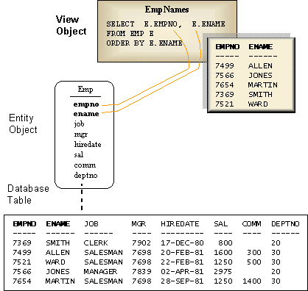
The figure shows the relationship between a view object, entity object, and the underlying database table. A view object named EmpNames operates on the Emp entity object to provide a view of the EMPNO and ENAME columns of the EMP table.

Slide 12
Uses
Provide an additional level of security by restricting access to a predetermined set of rows and columns. For example, you could create a view object where columns containing sensitive data (such as salaries) are not selected.
Hide data complexity. For example, a view object can display columns or rows from multiple entity objects. Such a view object hides the fact that the data is coming from several tables.
Customize presentation. Using a view object, you can rename columns without affecting the entity objects on which the view object is based.

Slide 13
Contd…
Store complex queries. A query could perform extensive calculations on table data. By saving this query in a view object, the calculations are performed only when the view object's query is executed. The calculation is executed before the data is retrieved from the database.
Improve efficiency of the application by using fast-executing, optimized SQL, selecting only the data we need.

Slide 14
Document Object
Document object is a document that represents object in HTML, XHTML, and XML documents.
The nodes of every document are organized in a tree structure, called the DOM tree. The HTML document object is the owner of all other objects in web page.
When an HTML document is loaded into a web browser, it becomes a document object.
The document object is the root node of the HTML document and the "owner" of all other nodes:(element nodes, text nodes, attribute nodes, and comment nodes).

Slide 15
Contd…
The document object provides properties and methods to access all node objects, from within JavaScript. The document is a part of the window object and can be accessed as window.document.
Depending on the kind of the document (e.g. HTML or XML) different APIs may be available on the document object.
All document objects implement the DOM Core Document and Node interfaces, meaning that the "core" properties and methods are available for all kinds of documents.

Slide 16
Document-view architecture
The document-view architecture is a Microsoft way of separating how and where a programs data ( objects ) are stored and how they are viewed.
The document stores the data and manages printing the data and coordinates updating multiple views of the data.
The view displays the data and manages user interaction with it, including selection and editing.
The view obtains display data from the document and communicates back to the document any data changes

Slide 17
Contd…
We need multiple views of the same document, such as both a spreadsheet and a chart view.
It makes it easy to support multiple views, multiple document types, splitter windows, and other valuable user-interface features.

Slide 18
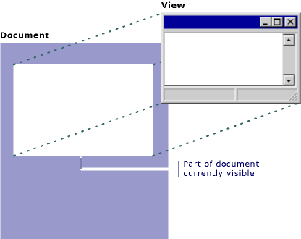
The following figure shows the relationship between a document and its view.

Slide 19
Advantages of the Document/View Architecture
The key advantage to using the MFC document/view architecture is that the architecture supports multiple views of the same document particularly well.
That function notifies all of the document's views, and each view updates itself using the latest data from the document.

